Slide 1

On Enforcing the Digital Immunity of a Large Humanitarian Organization
Stevens Le Blond, Alejandro Cuevas, Juan Ramon Troncoso-Pastoriza, Philipp Jovanovic, Bryan Ford, Jean-Pierre Hubaux

Slide 2
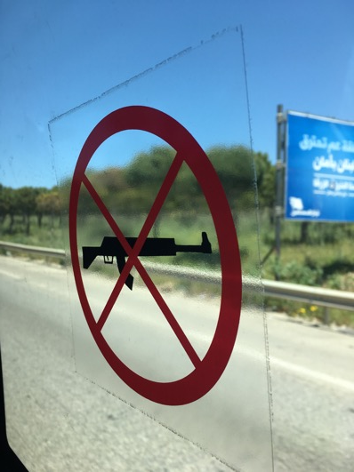

Slide 3
Digital immunity
“Computer security and privacy encompassing technical &
organizational factors, and privileges and immunities (P&I)”
What practical factors influence use of security tech by humanitarian orgs?

Slide 4
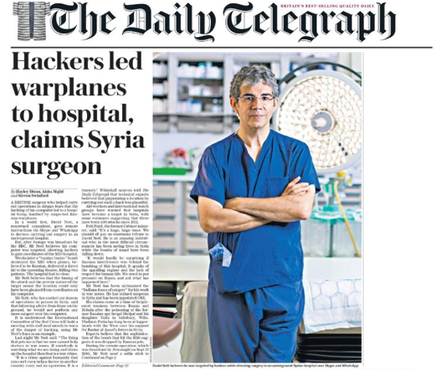
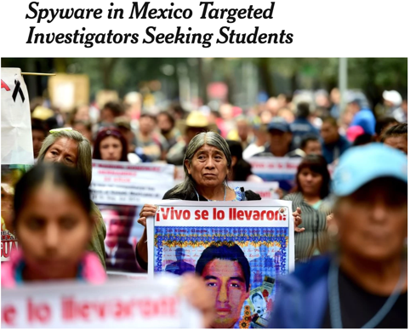

Slide 5
Outline
The International Commitee of the Red Cross (ICRC)
Methodology
Results
Data collected
Data flows
Operational and legal factors
Proposed architecture

Slide 6
Outline
The International Commitee of the Red Cross (ICRC)
Methodology
Results
Data collected
Data flows
Operational and legal factors
Proposed architecture

Slide 7
Characteristics of the ICRC
$
x3 Nobel
Peace Prices
16,000
employees
2.1 billion
annual budget
At-risk
operations
Privileges &
Immunity (P&I)

Slide 8
Privileges and Immunities (P&I) 1/2
Bilateral
agreement
Armed conflicts
Inviolability
of premises
Freedom of
communications

Slide 9
Privileges and Immunities (P&I) 2/2

Slide 10
Outline
The International Commitee of the Red Cross (ICRC)
Methodology
Results
Data collected
Data flows
Operational and Legal factors
Proposed architecture

Slide 11
Methodology
Inductive
approach
Qualitative
methods
27 interviews until
topic exhaustion
278 years
of experience

Slide 12
Summary of interviews

Slide 13
Location of ICRC delegations
Participants
Others

Slide 14
Outline
The International Commitee of the Red Cross (ICRC)
Methodology
Results
Data collected
Data flows
Operational and legal factors
Proposed architecture

Slide 15
Outline
The International Commitee of the Red Cross (ICRC)
Methodology
Results
Data collected
Data flows
Operational and legal factors
Future work

Slide 16
Summary of collected data types by units

Slide 17

Sensitivity of Collected Data
Beneficiaries
Organization
Governments

Slide 18
Outline
The International Commitee of the Red Cross (ICRC)
Methodology
Results
Data collected
Data flows
Operational and legal factors
Proposed architecture

Slide 19
Overview of data flows
Participants
Others

Slide 20
Outline
The International Commitee of the Red Cross (ICRC)
Methodology
Results
Data collected
Data flows
Operational and legal factors
Proposed architecture

Slide 21
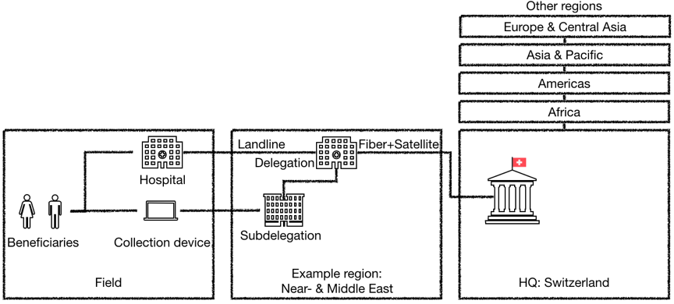
Organizational structure
HQ

Slide 22
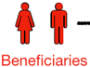
Practical factors
Vulnerability
HQ

Slide 23

Practical factors
Vulnerability
Capacity
building
Coercion
HQ

Slide 24
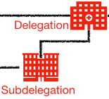

Practical factors
Vulnerability
Capacity
building
Coercion
Physical
attacks
HQ

Slide 25
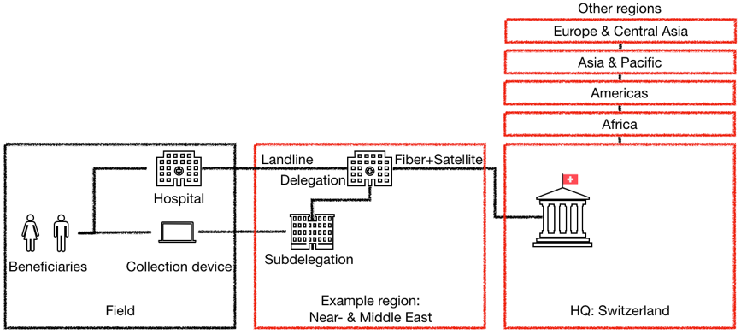
Practical factors
Vulnerability
Capacity
building
Coercion
Physical
attacks
Legal
factors

Slide 26
Lessons learnt
Data management rights should be granted on a need basis and should take citizenship, Privileges and Immunities (P&I), and susceptibility to coercion into account.
Operational security might need to be traded off to accommodate the needs and requirements of beneficiaries, field workers, and local authorities.
The ability of establishing secure communications among field workers and beneficiaries depends on their P&I, physical locations, and technological capability (or IT service).
Data protection can hamper humanitarian action; in particular, jurisdictions with conflicting legislations can preclude data sharing.
P&I enable humanitarian activities in adversarial environments; however, to be effective, they must be complemented with operational and technological safeguards.

Slide 27
Outline
The International Commitee of the Red Cross (ICRC)
Methodology
Results
Data collected
Data flows
Operational and legal factors
Proposed architecture

Slide 28
Needs of ICRC staff
(Low)
(High)

Slide 29
Problems with existing communication technology
no end-to-end
encryption
Meta-data
leakages
Personal
smartphones
Need for privacy-enhancing network for organizational communications

Slide 30
Organizational structure and practical factors
Vulnerability
Capacity
building
Coercion
Physical
attacks
HQ
Legal
factors

Slide 31
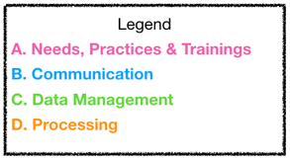
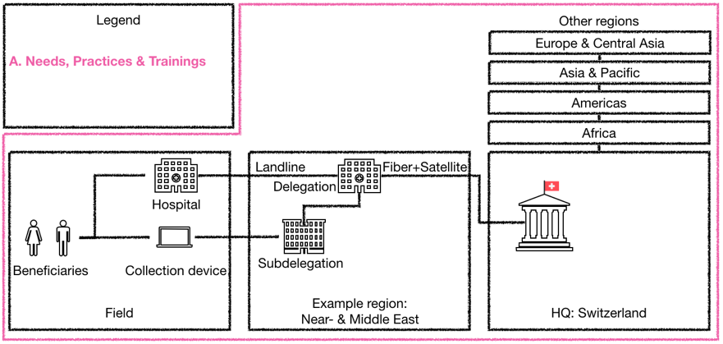
Proposed architecture
Vulnerability
Capacity
building
Coercion
Physical
attacks
HQ
Legal
factors

Slide 32
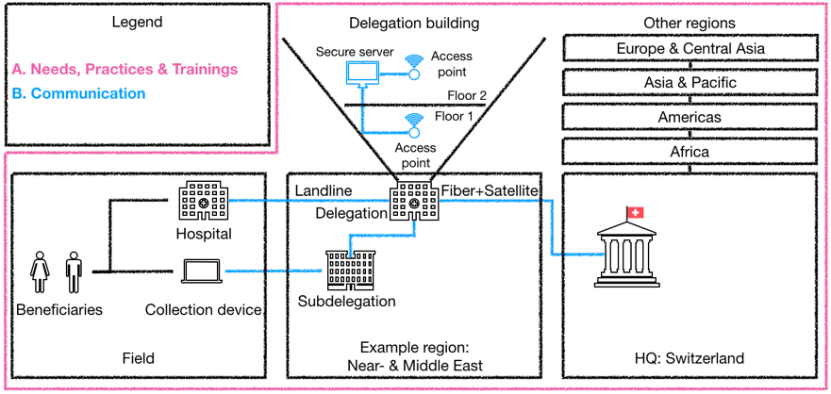
Proposed architecture
Vulnerability
Capacity
building
Coercion
Physical
attacks
HQ
Legal
factors

Slide 33
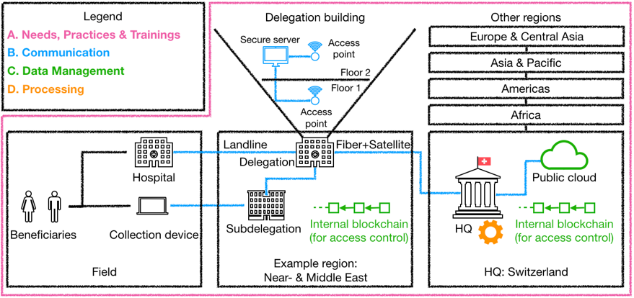
Proposed architecture
Vulnerability
Capacity
building
Coercion
Physical
attacks
Legal
factors

Slide 34
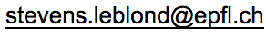
Take home messages
Need for secure communications, data management, and processing robust to coercion, lack of physical security and asymmetric legislations
Deploy a technological platform tailored to these legal and organizational factors
Create a foundation combining academic and industrial capability to deploy security tech at ICRC and other humanitarian organizations

Slide 36
How did you recruit participants?
Recruited participants both laterally (across divisions) and vertically (from field workers to heads of divisions)
Began interviewing employees with experience collecting & managing humanitarian data
As organizational, technical, and legal aspects emerged, we included managers, ICT and DPO personnel

Slide 37
How did you prepare and analyzed the interview data?
Two researchers recorded and transcribed all interviews (25 hours of recording and 150,000 words of transcriptions)
One researcher lead the interview while the other did an initial coding so new themes could be quickly incorporated
After interview both researchers discussed the set of codes adding more codes if consensus wasn’t reached
Interactively developed conceptual categories in which relevant excerpts were clustered

Slide 38
What is your assessment of the validity of your study?
Following Maxwell model for validity in qualitative studies:
Descriptive validity by saving audio recording of the interviews & performing verbatim transcriptions
Absence of significant disparities of the participants’ accounts during coding (interpretative validity)
Internal generalizability on the ICRC practices due to diversity of geographical areas of operations (no external generalization)
Omit theoretical and evaluative validity as we do not attempt to explain why observed phenomena occur nor dis/credit practices in place

Slide 39
What are the potential biases of your study?
Many participants and units and extensive experience likely representative of the needs and practices of the ICRC (self-selection bias)
Availability of ICT and DPO likely correlate to better practices (availability of resources and individuality)
Geographic reach, years of experience, and rigorous methodology make us confident that our results capture security challenges (small sample-size)

Slide 40
What was your interview script?
Identified areas of interest by reviewing the ICRC’s data protection rules & refined it with our liaison
Trial run with participant with 20 years of experience and incorporated feedback
Drew from instruments utilized by related work
Our questionnaire comprised seven categories (cf. Appendix A):
Background
Data collection
Data processing
Data transfers
Data breaches and security
Information security training
General security practices

Slide 41
How does the ICRC compare with other humanitarian organizations?
ICRC is an International Organization (IO) whose mandates follow from the Geneva conventions
Benefits from better Privileges and Immunities than most humanitarian NGOs
Operates both within government-provided infrastructure and its own privately-owned infrastructure

Slide 42
How does the ICRC compare with journalistic organizations?
Both threat models involve governments, armed forces, and criminal organizations
Operational security of journalists is tailored to one or few individuals, although ICRC often has dozens or more field workers
Unlike freedom of the press, the ICRC’s legal protection is captured in bi-lateral agreements with host countries

Slide 43
How did you ensure that interviews were conducted ethically?
Study approved by IRB
Informed consent from all participants to participate in the study and record the interviews’ audio
Audio files were transmitted and stored only in encrypted form and some information was redacted
Possibility to withdraw from study up to 30 days after the interview (P24 chose to do so)

Slide 44
What precautions will you take before deploying your proposed platform?
Designs will be peer-reviewed
Implementations will be open sourced and audited by independent experts
Integration will be delegated to a foundation based in Switzerland

